Slide 1
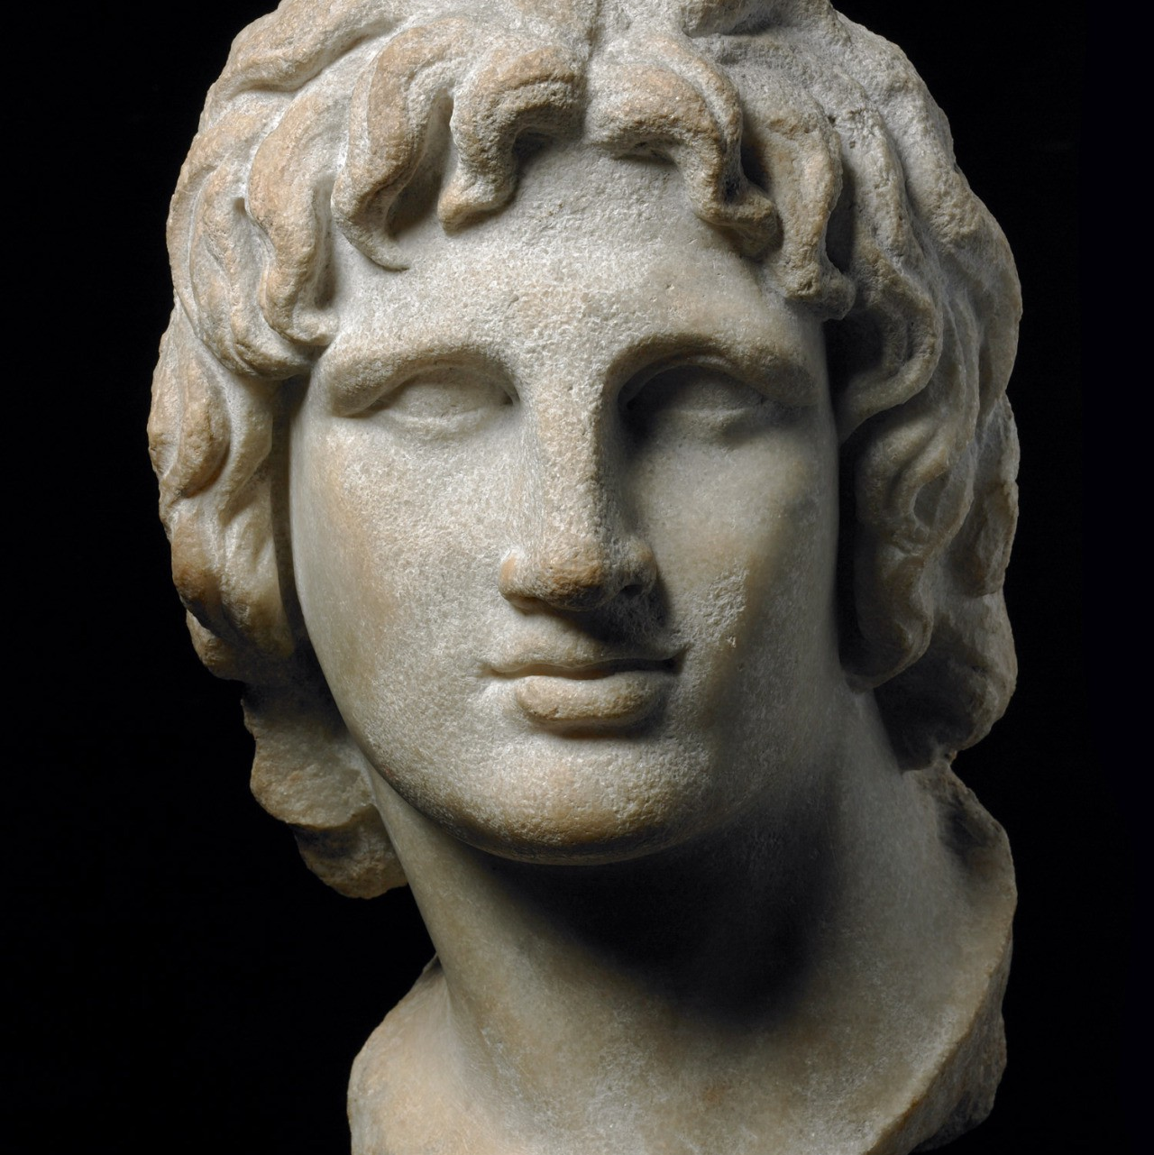
Key Battles
Year 11 Ancient History
Week 2 – Lesson 3

Slide 2
Activity 1: Source Study – PERSIA
Read through Sources 1 – 4. Answer the following two questions about each of the sources using dot-points.
a) Identify the key PEOPLE, EVENTS, and IDEAS.
b) What does this source teach you about Alexander the Great?

Slide 3
Activity 2: Key Battles
Use a laptop to fill research key information about each battle identified on the worksheet.
You must list key PEOPLE, EVENTS, and IDEAS.
Dot-points only.
MUST be finished by the end of the lesson, or it will become homework.

